Slide 1
Sure ways NOT to receive your scholarship
OUTSTANDING SCHOOL FEES
NO THANK-YOU LETTER

Slide 2
How to write a good thank-you letter
Keep it sincere (NO AI)
Keep it formal
Keep it concise
Proof-read

Slide 3
Address the scholarship/bursary donor(s) properly

Slide 4
Get right to the point and express your thanks in the first sentence

Slide 5
Mention a specific detail or two: e.g., how this money will help you attain your goal

Slide 6
Wrap it up with gratitude and give a warm sign-off

Slide 7
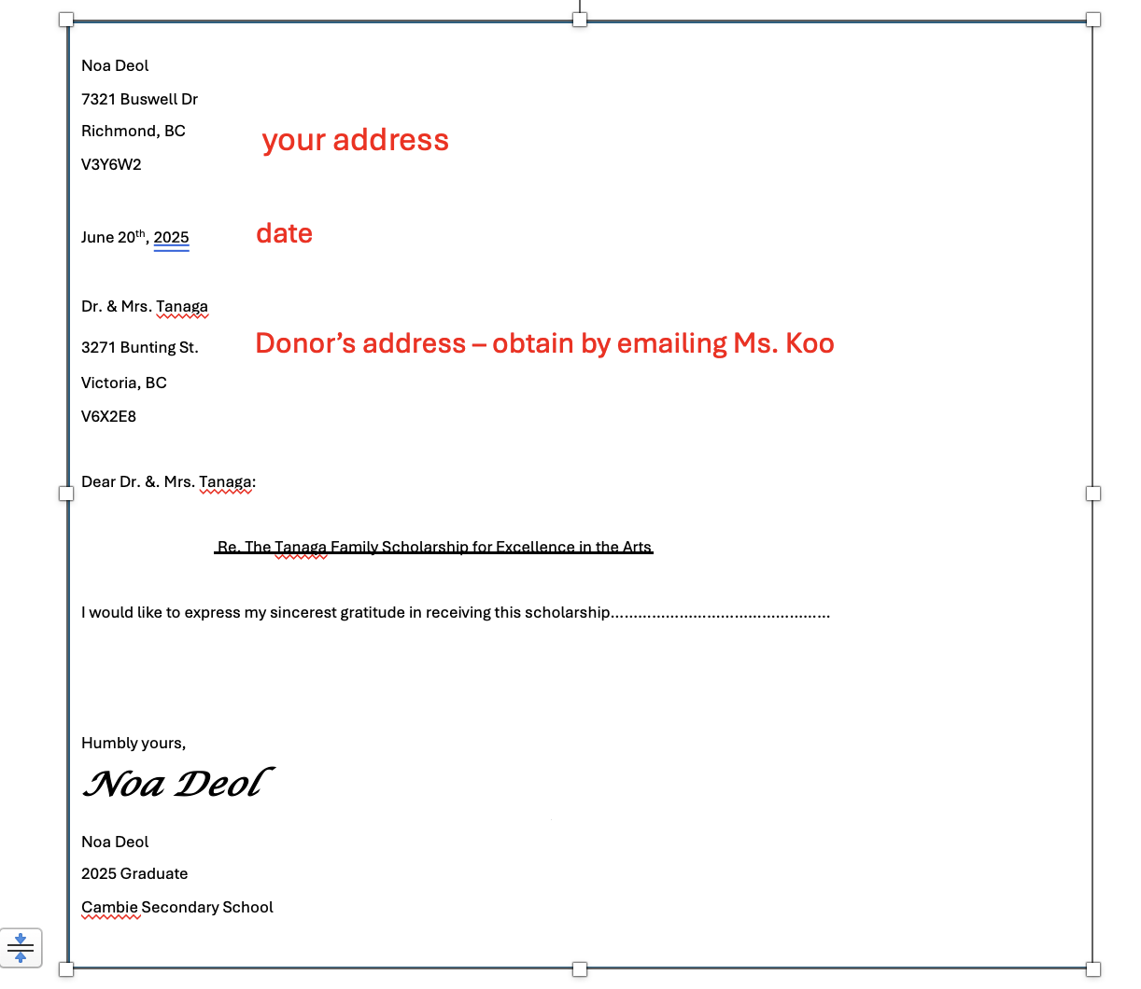

Slide 8
I will insert your photo with the scholarship presenter at valedictory before mailing your thank-you letter.

Slide 9
Word Doc or Google Doc E-copies due to Ms. Koo by June 20th for proof-reading skoo@sd38.bc.ca
Ms. Koo returns proof-read e-copies to writers by June 23th
Final hardcopies to Ms. Koo by June 26th
Final copies can be written by hand or typed
Use a larger-sized envelope (24 X16 cm). Remember to write your return address in the upper lefthand corner
Remember to affix a stamp to the envelope
Insert your letter in the envelope but do not seal your letter

Slide 10
RECIPIENTS OF THE DISTRICT/AUTHORITY SCHOLARSHIPS
NO need to provide a stamp or address on your envelope
Therefore, no need to email Ms Koo for donor’s address
Cambie will mass mail them
HAND IN YOUR THANK-YOU LETTERS TO MS HUI

Slide 11
Important Information for accessing your scholarship/ bursary funds
Make sure Cambie has your correct email address that you will be checking regularly
Make sure Cambie has your correct mailing address and phone number – last year 2 scholarships were not claimed because we could not reach the scholarship recipients once they graduated
Make sure you let Ms. Ng know immediately if you are taking a gap year or if you are NOT going to post-secondary school
The rest of you please pay your tuition fees first. Email your tuition receipt to Ms Ng and she will disburse your scholarship to you: ming@sd38.c.ca

