Slide 1
Program Planning
(into) Grade 9-12
H. J. Cambie Secondary
Notes:
Nik

Slide 2
WELCOME!
Administration:
Marcy Timmins – Principal
Sarah Ardat – Vice Principal
Nik Nashlund– Vice Principal
Counsellors:
Susan Koo Last Name A-L
Patsy Wilding Last Name M-Z
Notes:
Nik

Slide 3
FOUNDATION FOR LEARNING (WHY?)
Build character in our students
Develop Core Competencies
Focus on big ideas
Connect learning between subject areas
Make learning meaningful
Embrace the growth mindset
Notes:
Nik

Slide 4
OVERVIEW
Entering Grade 9 (Sept 2023)
Entering Grade 10, 11, or 12 (Sept 2023)
What courses do I choose?
Post-Secondary Options
Apprenticeship Programs
Course Selection Process
Important Dates
Notes:
Nik

Slide 5
THE CURRICULUM
  2022-2023
    K-12 is in Full Implementation of redesigned curriculum
    Still some transition as any change takes time
    Assessments in Numeracy and Literacy now occur in Grades 10-12.
  Grade 10 Numeracy Assessment
  Grade 10 Literacy Assessment
  Grade 12 Literacy Assessment
Notes:
Nik

Slide 6
SO WHAT COURSES
DO STUDENTS NEED TO CHOOSE?
Notes:
Nik

Slide 7
ENTERING GRADE 9 – SEPT 2023
  Program (Regular or Pathways)
  English Language Arts 9
  Social Studies 9
  Science 9
  Physical &Health Educ. 9
PLUS
  Mathematics 9 / Math 9 Adapted
  Elective - Applied Skill (Computers, EDD, Woodwork, Electronics, Textiles, Foods)
  Elective - Fine Art (Art, Photo, Drama, Band)
  Elective – usually a language (French, Spanish, Mandarin)
Notes:
Nik

Slide 8
Gr 9 ELECTIVES
Art Education
  2D Draw/Paint
  3D Sculpture
  Photo
Business Education
  Non-credit Bus. Ed 10
Applied Skills
  Computer Tech.
  Woodwork
  EDD
  Robotics
Modern Languages
  French 9
  Spanish 9
  Mandarin 9
Music
Drama
Home Economics
  Foods
  Textiles
Many course options exist in each of these different areas. See the program planning book for more info.
Notes:
Nik

Slide 9
Core Competencies
Career Education 9
Students to reflect on strengths, preferences, and skills and how to develop and use these aspects in planning for their future lives and career plans.
To be completed outside of the regular classroom schedule through the online platform “MyBlueprint”.
All students must complete a self-assessment of the Core Competencies (Communication, Thinking, and Personal and Social) three times per year.
Teachers will provide assistance throughout the year, so January/April/June reflections are natural.
Notes:
Nik

Slide 10

Entering Grade 10,11,or 12
(GRAD PROGRAM)
Notes:
Bianca

Slide 11
ENTERING GR 10, 11, or 12 – SEPT 2023
  GRAD PROGRAM REQUIREMENTS.
  THERE ARE NO MORE PROVINCIAL EXAMS.
  Grade 12s (Sept 4 credits (one course) must be Indigenous Focussed
  STUDENT MUST COMPLETE 3 REQUIRED ASSESSMENTS:
      NUMERACY ASSESSMENT – GR. 10
      LITERACY ASSESSMENT – GR. 10
      LITERACY ASSESSMENT – GR. 12*
Notes:
Bianca

Slide 12
Grade 10-12 Grad Program
Students need a minimum of 80 credits to graduate.
Most courses are 4 credits.
Students must successfully complete courses to accumulate credits.
Some Post-Secondary programs have specific course requirements – do the research !!
Notes:
Bianca

Slide 13
REQUIRED COURSES
13 courses = 52credits
1. Composition & Focused Literacy Studies 10
2. English Studies 11
3. An English Studies 12
4. Social Studies 10
5. A Social Studies 11 OR 12
6. Math 10 (one of)
  Workplace Math 10
  Foundations of Math & Pre-Calculus 10
7. Math 11 (one of)
  Workplace Math 11
  Foundations Math 11
  Pre-calculus Math 11
8. Science 10
9. A Science 11 or 12
  Life Science 11
  Chemistry 11
  Physics 11
  Science for Citizens 11
10. Physical & Health Educ. 10
11. An Art Ed and/or ADST 10, 11, or 12
12. Career Life Education
13. Career Life Connections &
Capstone
Notes:
Bianca – ‘fairly’ quick as too many words…visual coming up.

Slide 14
ELECTIVE COURSES
7 courses = 28 credits
Art
Business Education
English
Home Economics
Modern Languages
Physical & Health Education
Theater / Drama
Sciences
Social Studies
Math
Technology Education
Computer Technology
Recreation Leadership
Medical Science
Music
Many course options exist in each of these different areas. See the program planning book for more info.
Notes:
Bianca – ‘fairly’ quick as too many words…visual coming up.

Slide 15
More of a visual or the ‘big picture’
Graduation Requirements
Grade 10 | Grade 11 | Grade 12
1. EN 10: Composition & Focussed Literary Studies 10 | 1. English Studies 11 | 1. English Studies 12
2. Socials 10 | 2. a Socials 11 or 12 | 2. Elective 12
3. a Math 10 | 3. a Math 11 | 3. Elective 12
4. Science 10 | 4. a Science 11 or 12 | 4. Elective 12
5. PHE 10 | 5. Career Life Education 11 | 5. Elective
6. Elective | 6. Elective | 6. Elective
7. Elective | 7. Elective | 7. Elective
8. Elective | 8. Elective | 8. Elective
One elective must be a Fine Art or ADST
Career Life Connections + Capstone
One course must be Indigenous Focused
Notes:
Bianca – This entire ppt is on our webstie: student > program planning > Grade 9-11 program planning

Slide 16
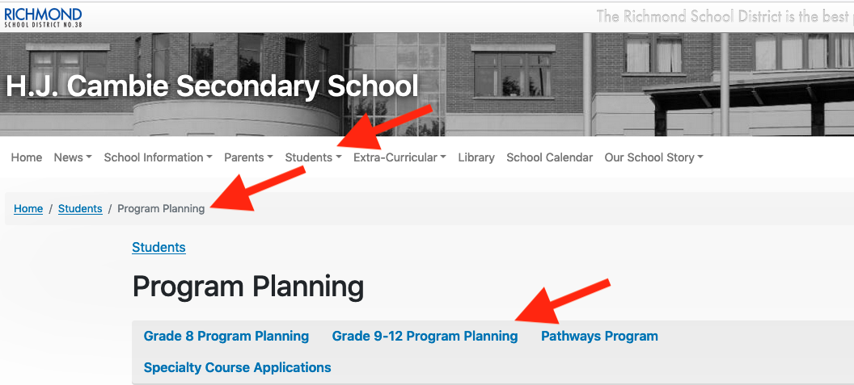
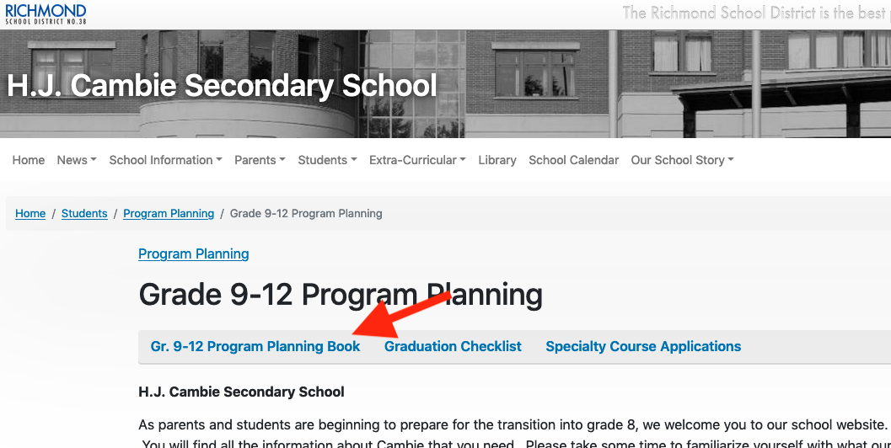
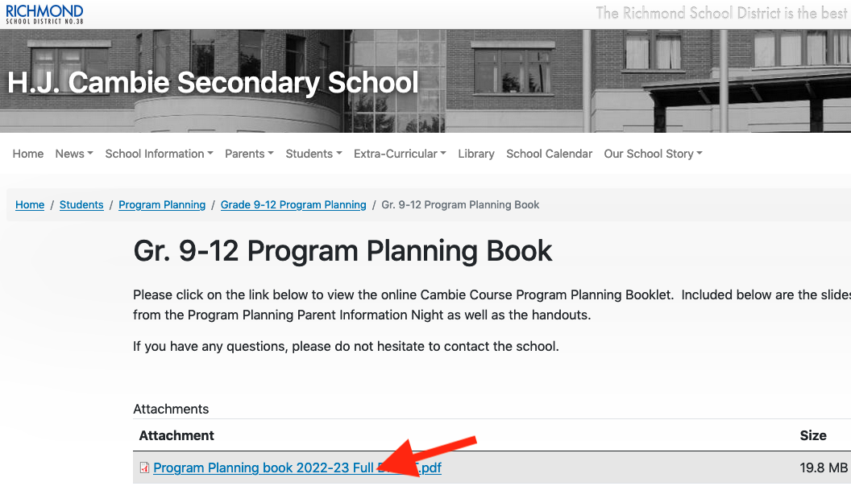
PROGRAM PLANNING GUIDE
(to see all your course options)
Notes:
Nik

Slide 17
Ex. A Math page.

Slide 18
WORK EXPERIENCE (WEX)
PROGRAMS
During Grade 11 or 12, students who choose WEX will complete 100-120 hours of work experience (also worth 4 credits).
Great opportunity for students to gain experience and learn more about career opportunities.
Marketing, Accounting, & Medical Science
Notes:
Bianca

Slide 19
CAREER PROGRAMS
YOUTH TRAIN IN TRADES
School Based
  Plumbing Palmer (16 credits)
  Professional Cook Richmond (16 credits)
Secondary School Apprenticeship (16 credits)
  Other opportunities such as…auto mechanics, baking, carpentry, electrical, masonry
TALK TO YOUR COUNSELLOR FOR MORE INFO
Notes:
Bianca

Slide 20
SOME THINGS TO CONSIDER....
Universities moving towards broader-based admission.
Grade 11 marks will be considered.
Check English or Math requirements in addition to graduation requirements for different programs .
Notes:
Nik

Slide 21

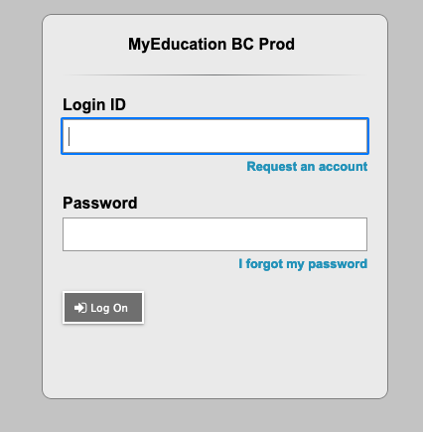
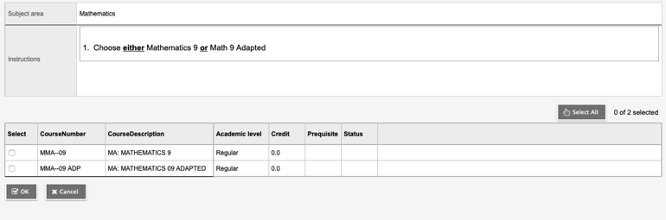
Entering Your Course Requests
For next year (2024-24)
1) My Info top-tab
2) Requests side-tab
3) In Primary Requests box, make selections for different subject areas.
4) Use ”OK” and “Post” buttons
If you need help, see your counsellor. Also, there is a library lunch session on Feb 9th.
For password resets, see main office for help.

Slide 22
COURSE SELECTION PROCESS
Feb. 7 Program Planning assemblies
Feb. 7 - Feb. 16 Students enter courses online at home via MyEdBC, same route as report cards.
Feb. 16 Course Selection sheets, signed by parents/guardians, with listed alternate options, are due to office.
Timetable built based on data from student requests
  Some classes may not run due to insufficient requests
  Late requests for changes may be difficult to accommodate
Notes:
Nik

Slide 23
CONTACT US!
Counsellors check credits, and progress towards graduation.
Counsellors can advise on course selection to ensure that post-secondary options are accessible.
THANK YOU FOR COMING!
Please continue with your self-guided Virtual Open House.
Notes:
Nik

